Slide 1
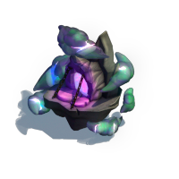
12
V
13
W
14
X
15
Y
16
Z
17
BA
18
BB
19
BC
20
BD
21
BE
22
BF
V
BG
W
BH
X
12
Y
13
Z
14
BA
15
BB
16
Green: Initial Plot
Yellow: Accessible with standard resources
Cyan: With special features
Orange: Needs Expansion Permits
Red: Needs Explorer’s Permits
Purple: Needs Windchaser Permits
Brown: Needs Desert Permits
Grey: Future expansion
BC
17
BD
18
BE
19
BF
20
BG
21
BH
22

